Slide 1


INNOVATE BHARAT HACKATHON 2026
TRACKS: School Student Innovation (SCHII)

Slide 2
Vehicle Safety System Using Fire and Alcohol Detection
Team Name: SafeRide Engineers
Team ID: SCHII103
Team Members:
Priyanshu Bhaskar
Raj Sisoudia
Somya Agarwal
Preeti Patel

Slide 3

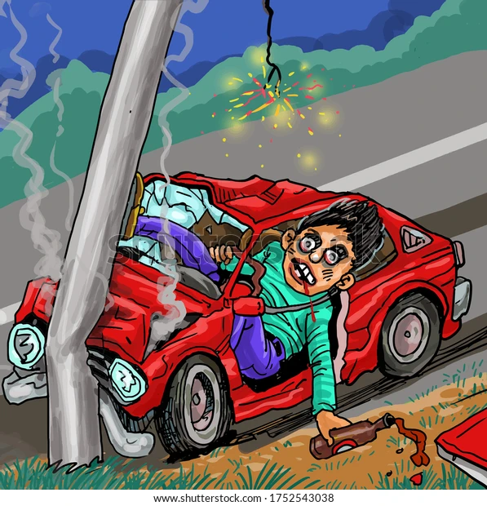

Problem Statement
Problem Statement
Road accidents due to drunk driving are a major cause of fatalities worldwide
Drivers under alcohol influence have reduced reaction time and poor judgment
Vehicle fire incidents often remain undetected in early stages
Lack of systems that provide:
Real-time monitoring
Automatic vehicle control
Immediate emergency communication
Need for a preventive and automated safety solution
‹#›

Slide 4
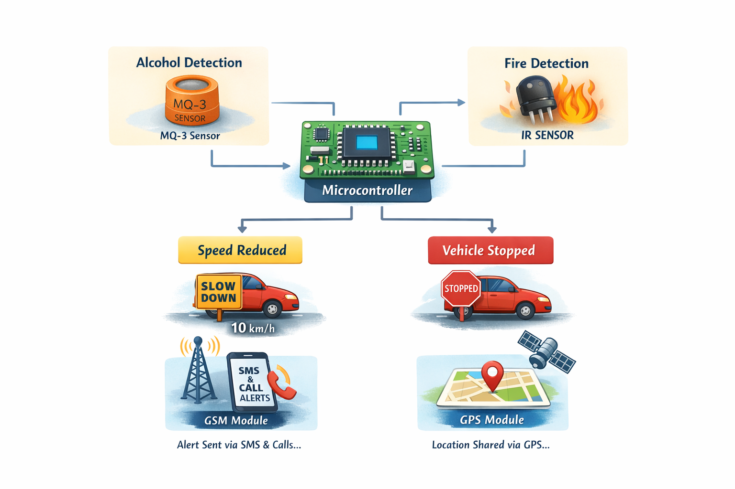
Proposed Solution / Idea
Problem Statement
Proposed Solution/Idea
We propose a smart embedded system that:
Detects alcohol consumption using MQ-3 sensor
Detects fire hazards using IR sensor
Automatically:
Reduces vehicle speed to a safe limit (~10 km/h)
Stops vehicle if necessary
Sends SMS and calls via GSM module
Shares real-time GPS location
‹#› W
‹#›

Slide 5
Proposed Solution / Idea
Problem Statement
Innovation & Uniqueness
All-in-One Safety System – Integrates alcohol detection, fire sensing, GPS tracking, and GSM alerts in one platform
Automatic Vehicle Control – Reduces speed (~10 km/h) or stops vehicle during emergencies
Dual Detection Mechanism – Monitors both driver condition and vehicle environment
Real-Time Alerts with Location – Sends instant SMS, call, and live GPS coordinates
Designed for Heavy Vehicles – Suitable for trucks, buses, and commercial transport
Safe Parking Approach – Gradual speed reduction instead of sudden stopping
Low-Cost & Scalable – Easy to implement in large fleets
‹#› W
‹#›

Slide 6
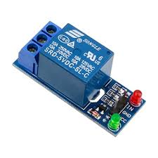
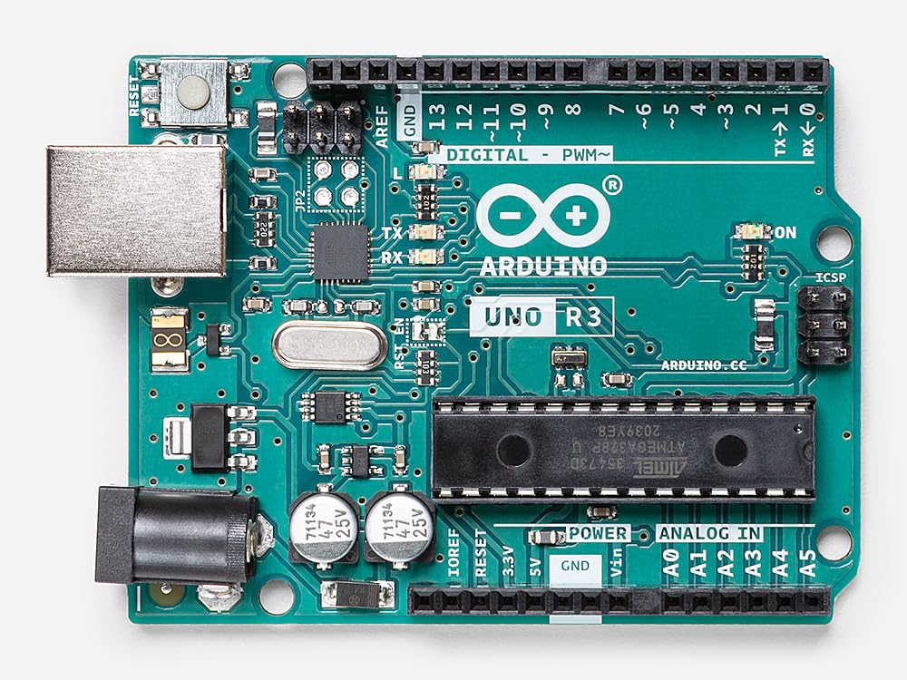
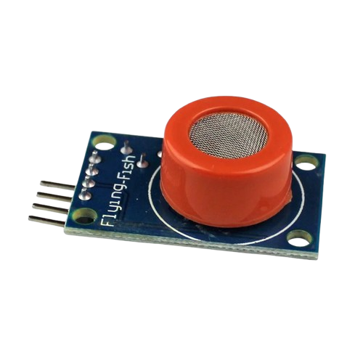
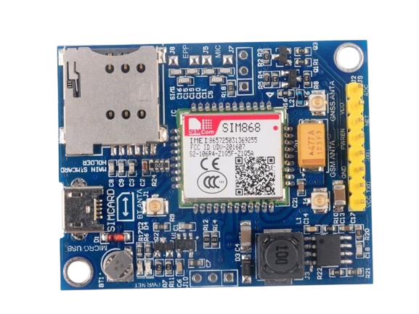

Proposed Solution / Idea
Problem Statement
Technology Used
Arduino Uno (Microcontroller) Acts as the central processing unit to control all sensors and modules
MQ-3 Alcohol Sensor Detects alcohol concentration in the driver’s breath
IR Sensor (Fire Detection) Identifies fire or abnormal heat in the vehicle
SIM868 GSM + GPS Module Provides both communication (SMS/call alerts) and real-time location tracking in a single integrated module
Relay Module Controls vehicle motor to reduce speed or stop during emergency conditions
Buzzer Provides immediate audio alert when fire or alcohol is detected
Embedded System Design Integration of hardware and software for real-time monitoring and response
C/C++ Programming (Arduino IDE)
Used for implementing logic, sensor processing, and communication control
‹#› W
‹#›

Slide 7
Proposed Solution / Idea
Problem Statement
Features & Functionalities
Alcohol Detection Detects alcohol level in driver’s breath using MQ-3 sensor
Fire Detection System Identifies fire or abnormal heat using IR sensor
Automatic Vehicle Control Reduces speed (~10 km/h) or stops the vehicle during emergencies
Real-Time Alert System Sends SMS and makes calls to predefined emergency contacts
Live GPS Tracking Shares real-time location of the vehicle for quick response
Buzzer Alert Provides immediate audio warning inside the vehicle
Continuous Monitoring Sensors work continuously to detect any unsafe condition
Fail-Safe Operation Ensures safety actions are triggered instantly when risk is detected
‹#› W
‹#›

Slide 8
Proposed Solution / Idea
Problem Statement
Implementation Plan / Roadmap
Phase 1
Phase 3
Phase 5
Phase 7
Requirement Analysis
Module Testing
Software Development
Deployment
Define system requirements and design approach
Test GSM, GPS, and sensors separately
Write sensor logic and decision algorithms
Install in vehicle; validate real performance
1
2
3
4
5
6
7
Phase 2
Phase 4
Phase 6
Hardware Setup
Integration
Testing & Debugging
Assemble Arduino, sensors SIM868, relay, buzzer
Connect all components; verify communication
Full system test under different conditions
‹#› W
‹#›

Slide 9
Guidelines
Participants must use the official PPT template provided by the organizing committee for idea submission.
The presentation should be clear, well-structured, and limited to the recommended number of slides mentioned in the template.
Teams must ensure that all required sections are properly included in the presentation.
The content of the PPT must be original and created by the team members. Any form of plagiarism may lead to disqualification.
Use readable fonts, proper headings, and relevant visuals (charts, diagrams, flowcharts) to explain the idea effectively.
The PPT file should be submitted in .pptx or .pdf format using the prescribed file naming convention (TeamName_ProjectTitle).
Teams must ensure that all information provided in the presentation is accurate and relevant to the selected hackathon theme.

